Slide 1
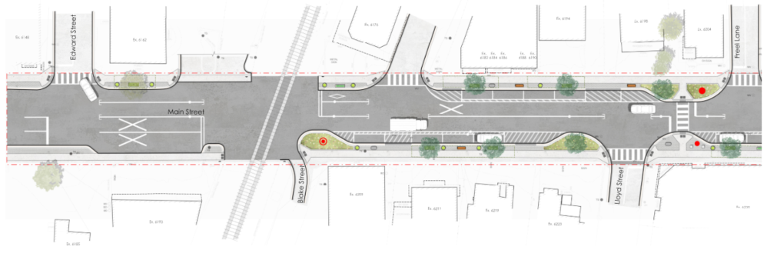
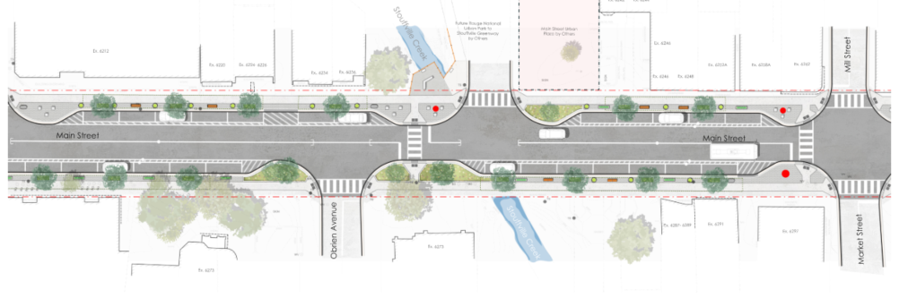
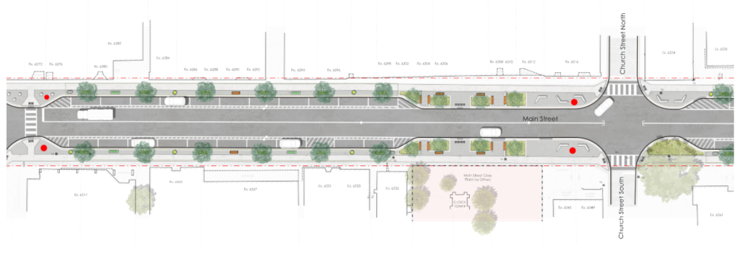
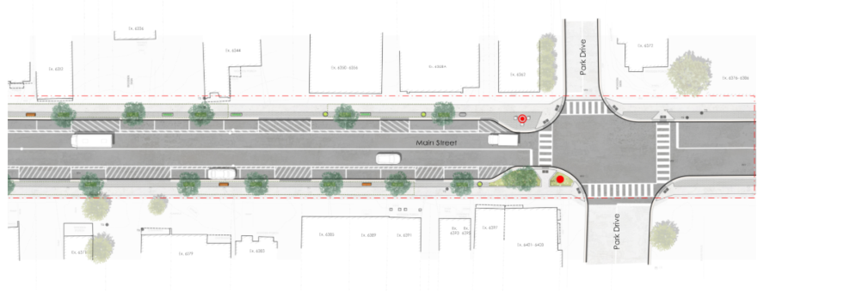
Design: Plan View
Notes:
I am now going to provide a brief overview of some of the features within the current design. These images are located on the boards behind me and you will have an opportunity to have a closer look at them after the presentation.
This plan view shows how the design fits within the corridor and how features are laid out in real space.
The layout reflects the trade offs we worked through to balance pedestrians, transit, parking, and roadway operations.

Slide 2
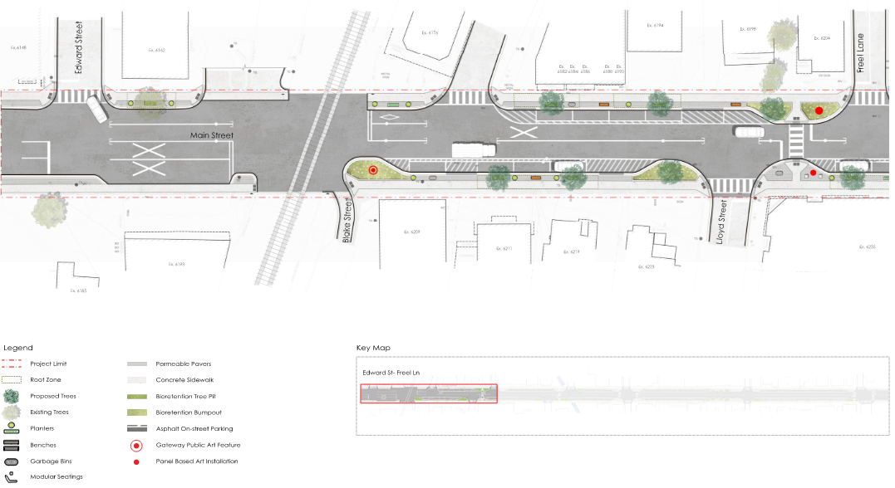
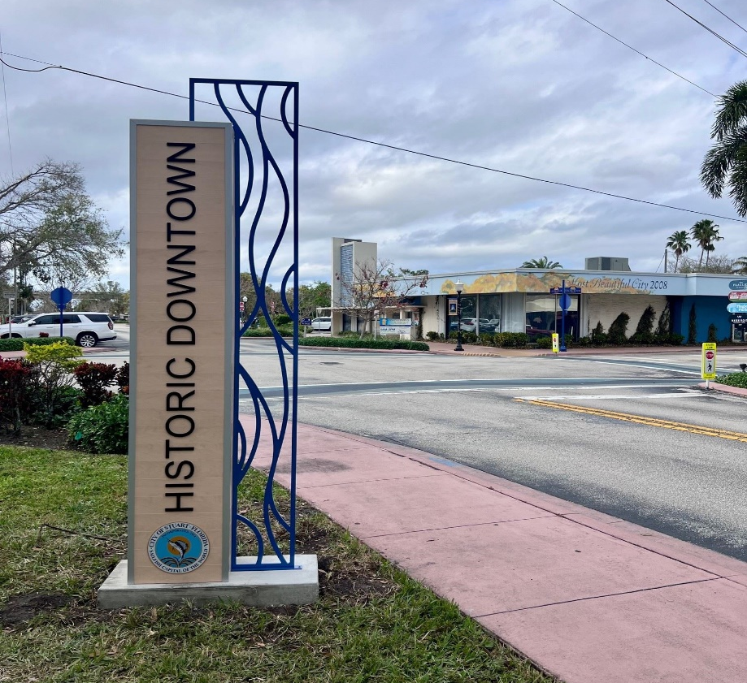
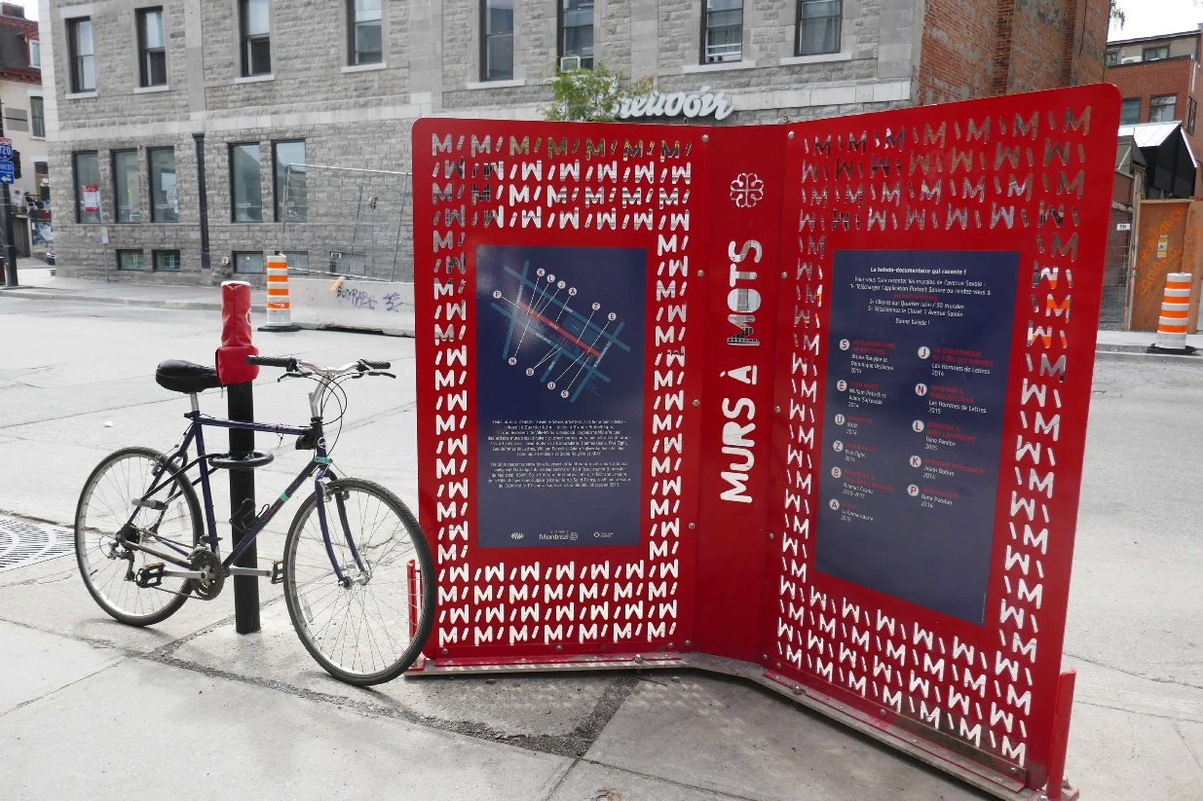
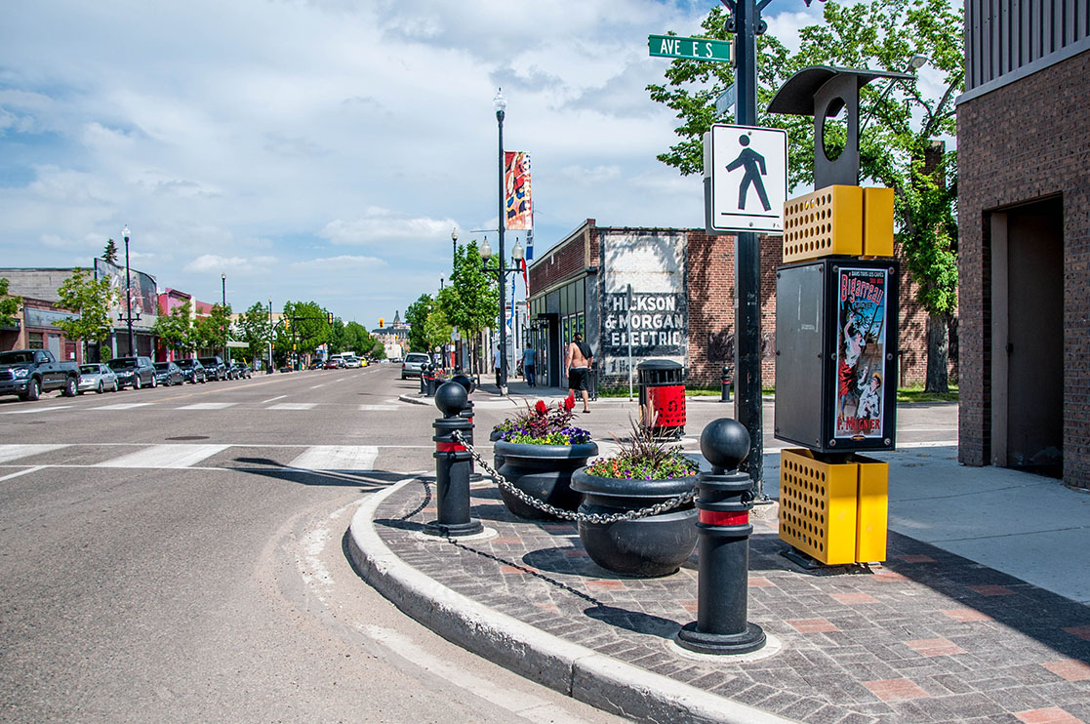
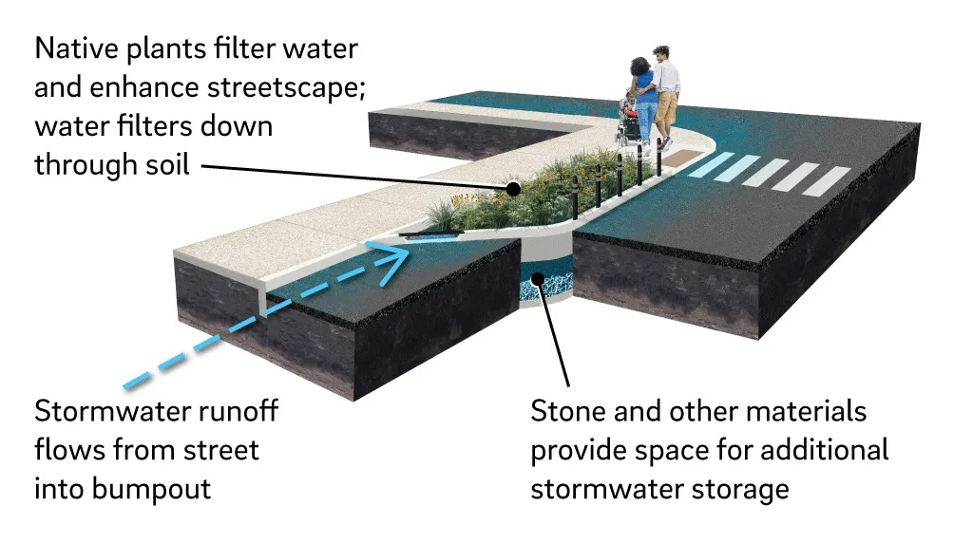
Signalization of Edward Street
Existing Pedestrian Crossing to Remain
Panel Based Art Features
Gateway Public Art Features
Bioretention Bump Outs
Restricted Access from Blake Street to Main Street
Notes:
This slide highlights key design decisions focused on pedestrian safety, access management, and downtown identity.
The signalization and crossing strategy is intended to improve safety and predictability at key locations.
The access adjustments are intended to reduce conflict points while still supporting local access needs.
Gateway features and public art elements respond to feedback about downtown character and the arrival experience.
Bioretention features add greenery while also functioning as stormwater management infrastructure.
We are currently reviewing intersection configuration options that will allow us to signalize Edward Street.
Access to Blake Street from Main Street will be a Right Turn Only. Access to Main Street from Blake Street will be restricted due to safety concerns with the train tracks.
The existing pedestrian crossing between Lloyd Street and Freel Lane will remain.
A gateway public art feature, similar to the example shown, is proposed within the Blake Street bump out.
Panel based public art features are proposed near the existing pedestrian crossing, with an example shown on the slide.
Bioretention features will be constructed within the bump-outs. As you can see in the image, stormwater runoff flows into the bump-out, The native plants enhance the streetscape and filter water. The water filters down through the soil in the granular sublayer that provides stormwater storage.

Slide 3
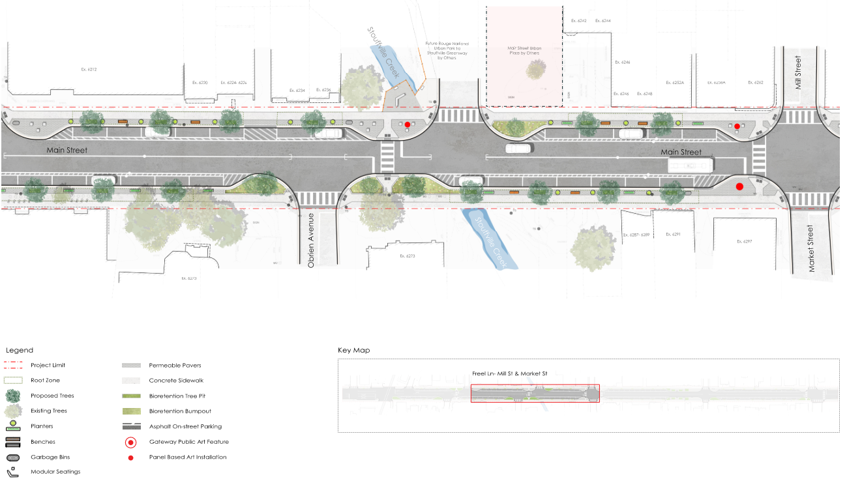
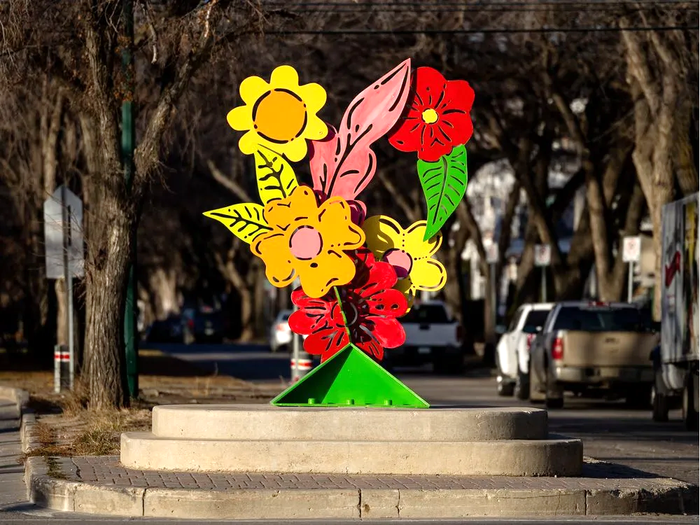
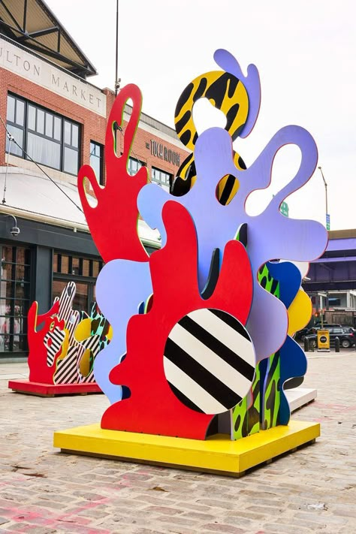
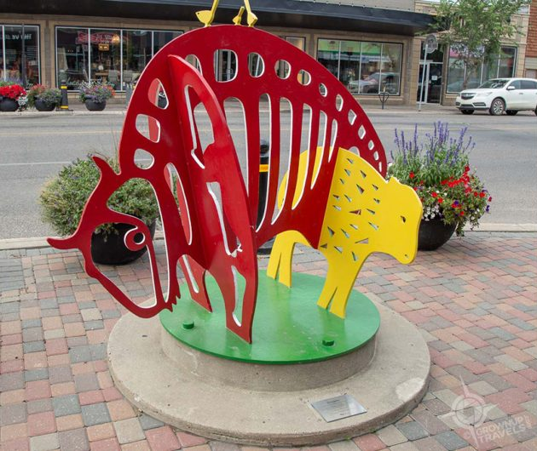
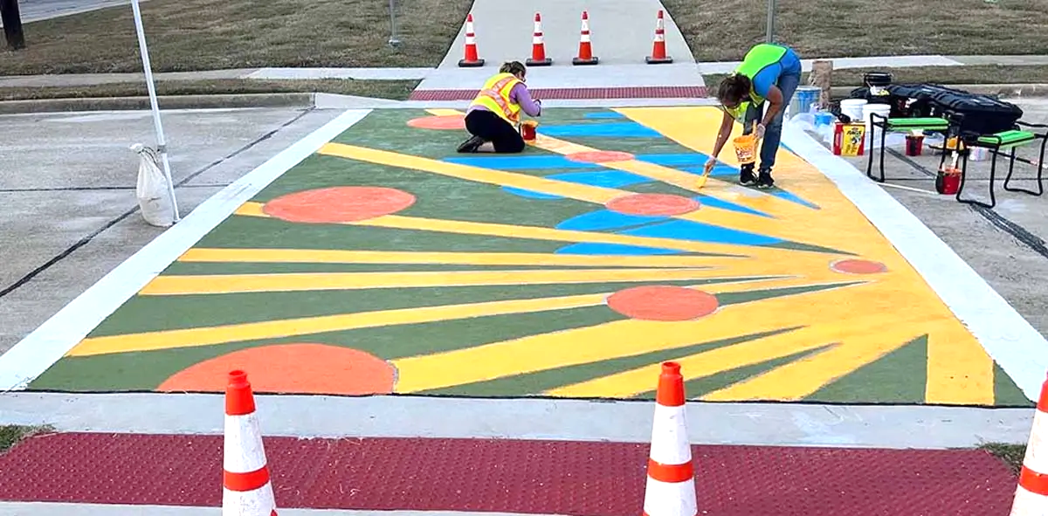
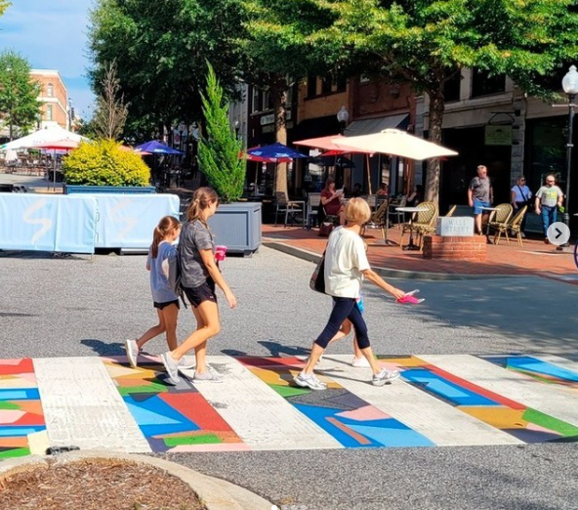
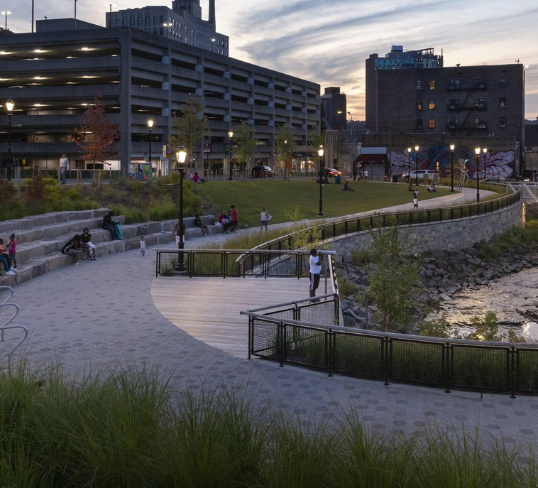
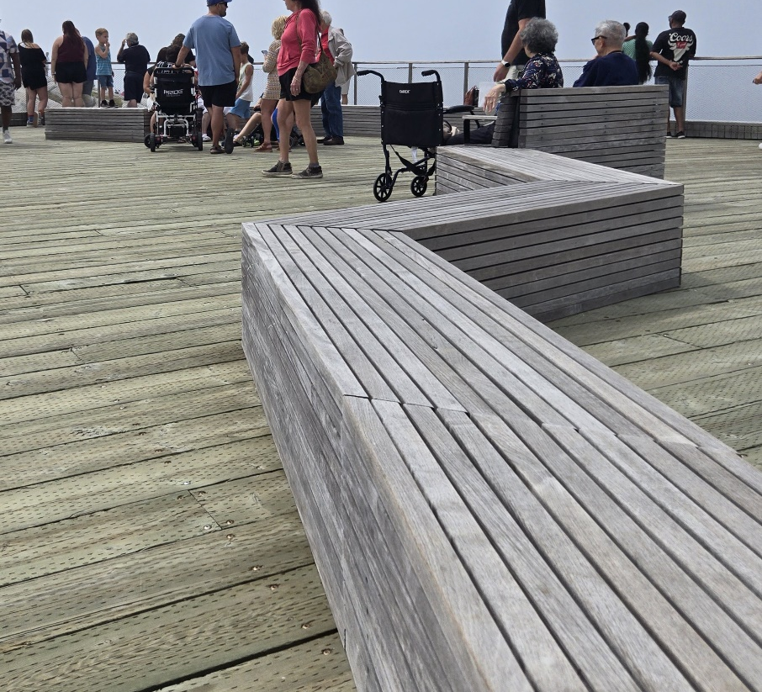
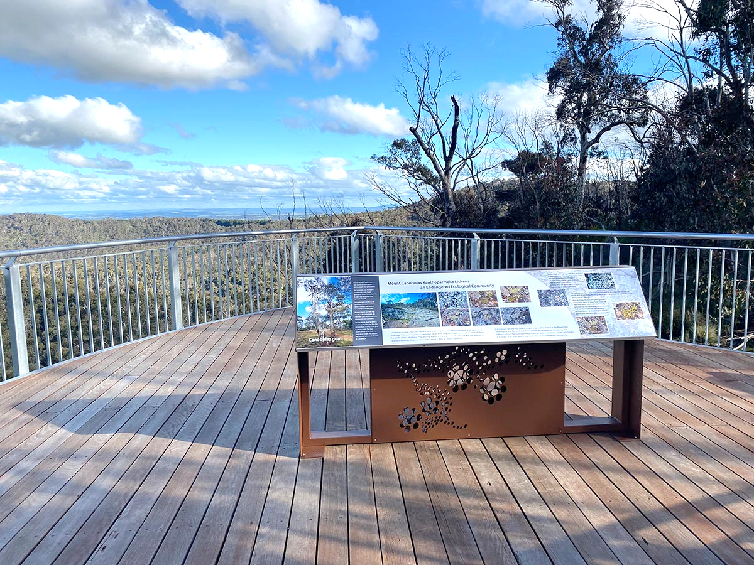
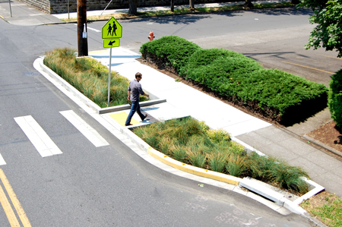
Meeting Lounge Area
New Pedestrian Crossing
Panel Based Art Features
Bioretention Bump Outs
Notes:
These elements reflect the direction we heard from the community about creating places to gather and improving walkability.
We incorporated a meeting lounge area in response to requests for seating and comfortable spaces to pause and spend time downtown.
The new pedestrian crossing responds directly to concerns about crossing safety and interconnecting a future trail.
The art panels and public realm features help reinforce downtown character without overwhelming the streetscape.
Panel based art features will be located near the pedestrian crossings.
Bioretention bump outs will be incorporated to enhance the streetscape and support stormwater management.
A new pedestrian crossing will be installed to allow pedestrians to safely access and gather near the Meeting Lounge Area.
The Meeting Lounge Area will be located here, creating a comfortable place to gather.

Slide 4
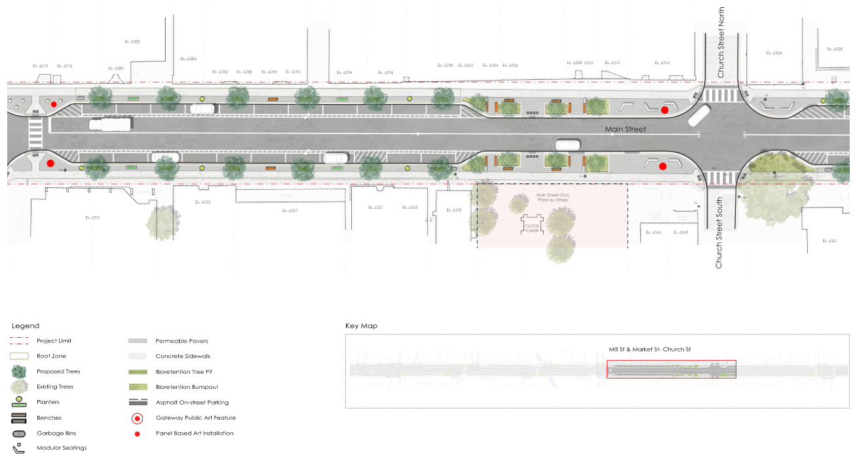
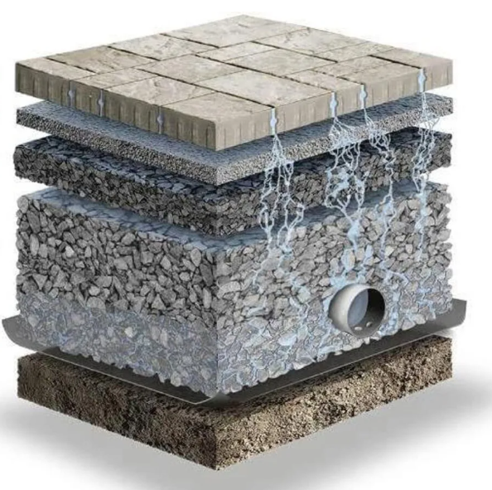
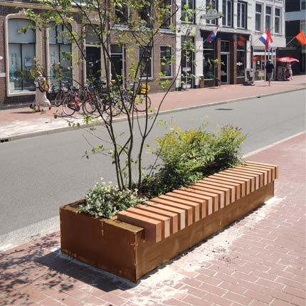
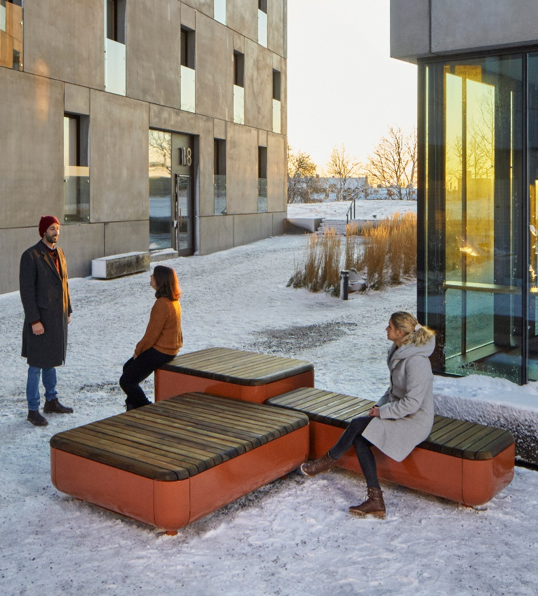
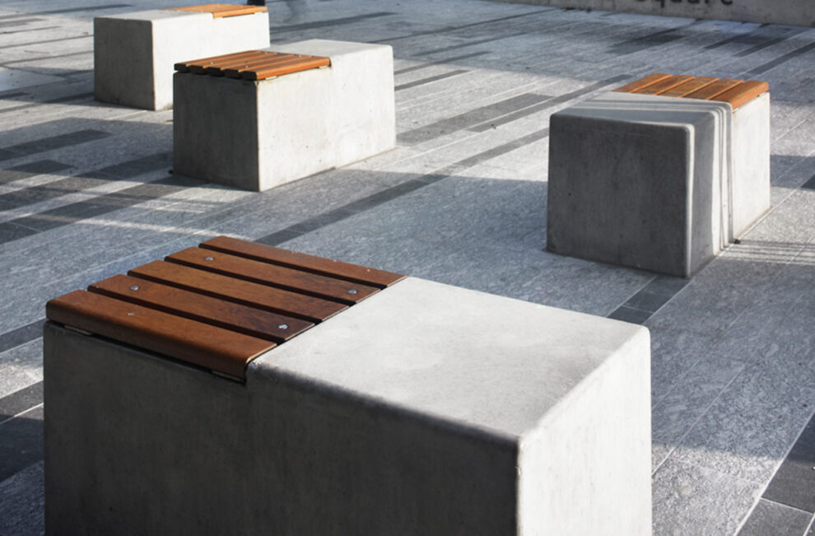
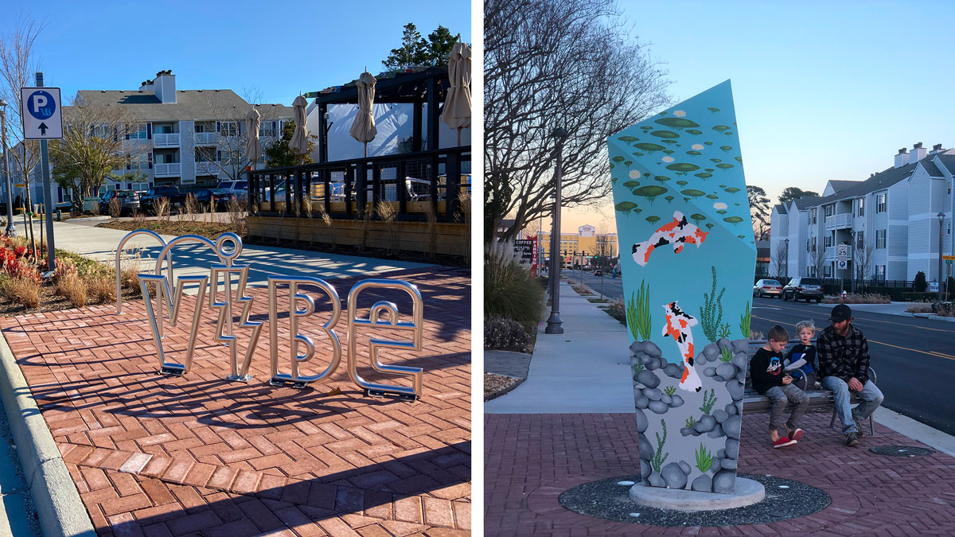
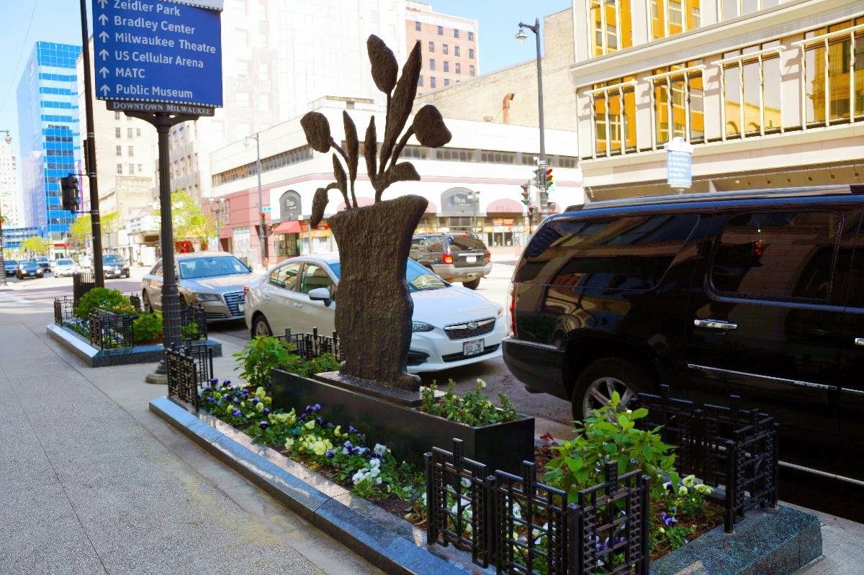
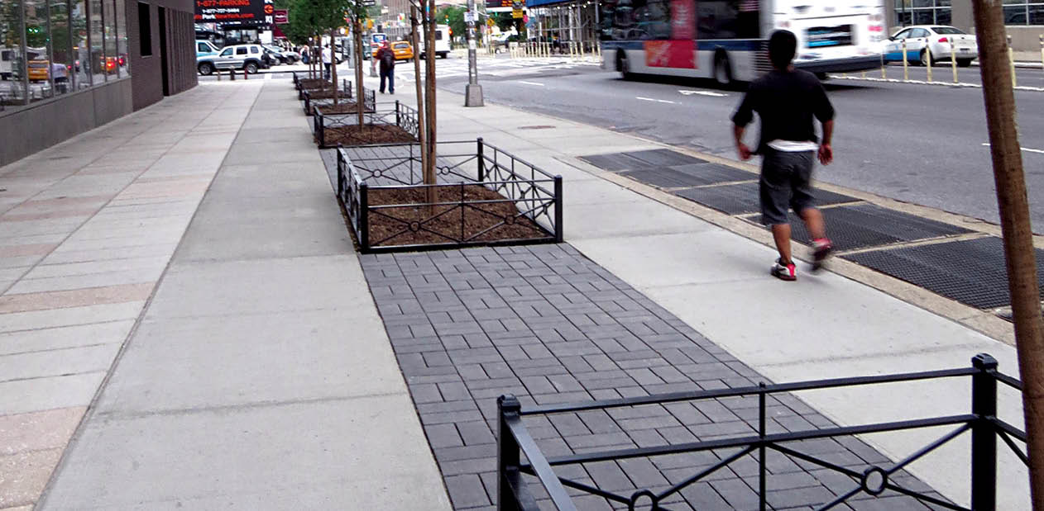
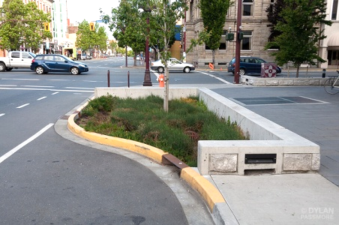
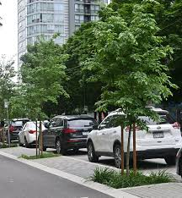
Modular Seating
Panel Based Art Features
Permeable Pavers
Bioretention Bump Outs and Tree Pits
Notes:
Modular seating supports everyday use and gives flexibility for events and seasonal programming.
Permeable interlocking pavers support stormwater management and help reduce runoff where conditions allow.
Tree pits and bioretention features add greenery, shade, and comfort while also improving drainage performance.
These features are intended to enhance the appearance of Main Street while functioning well over the long term.
Panel based are features will be located near the pedestrian crossings.
Bioretention tree pits will be incorporated to enhance the streetscape and support improved drainage.
Permeable pavers will be located within the boulevard between the curb and the sidewalk. Water will infiltrate through the permeable surface and filter into the underlying granular layers, which provide stormwater storage.
Modular seating will be located within the boulevard bump outs surrounding the Church Street intersection.

Slide 5
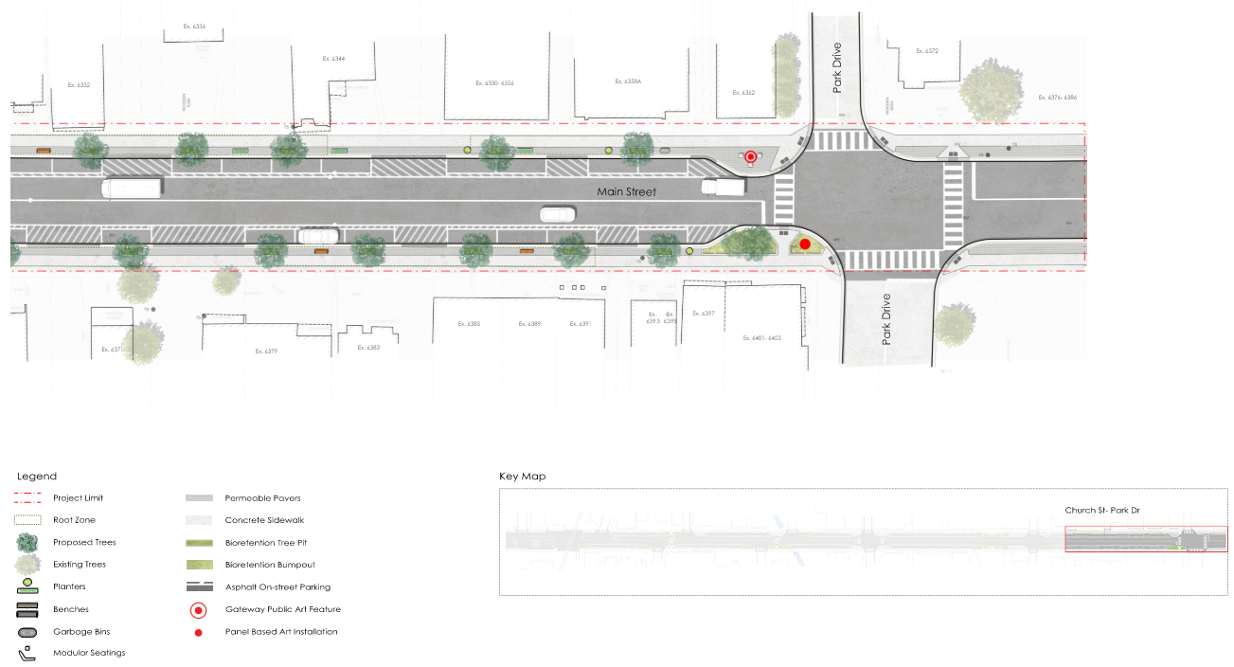
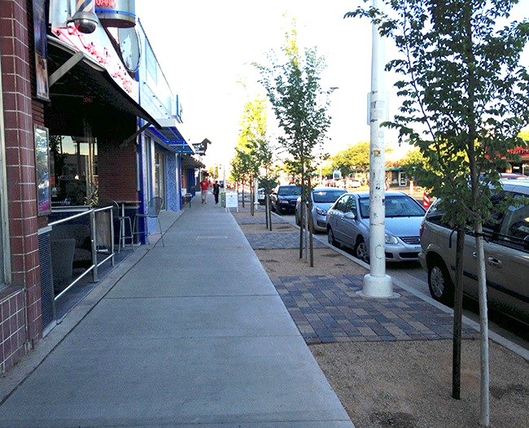
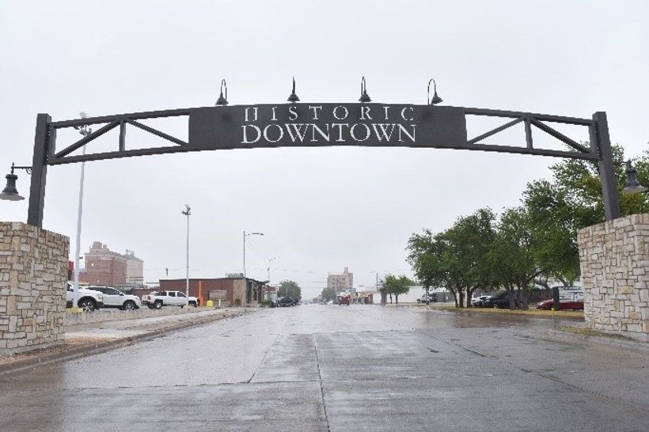
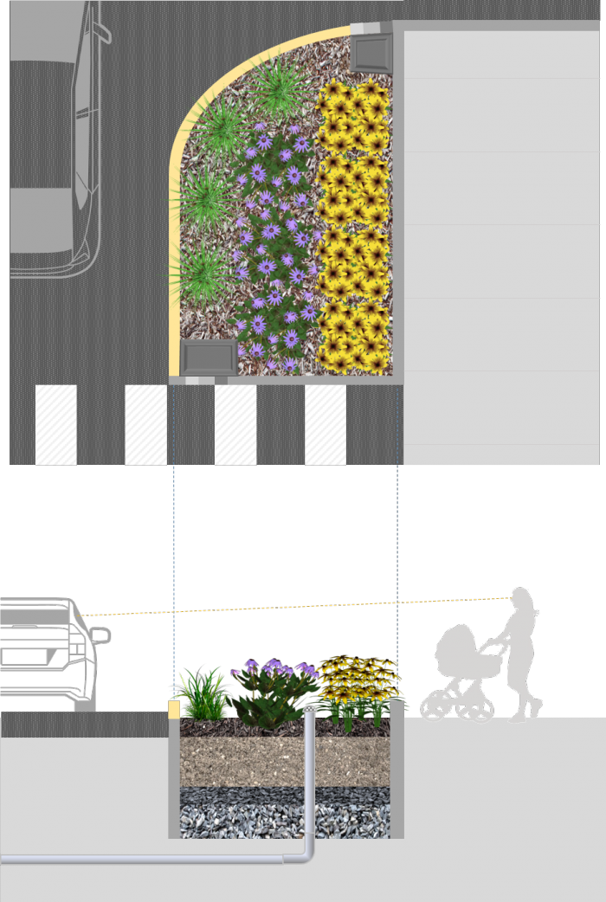
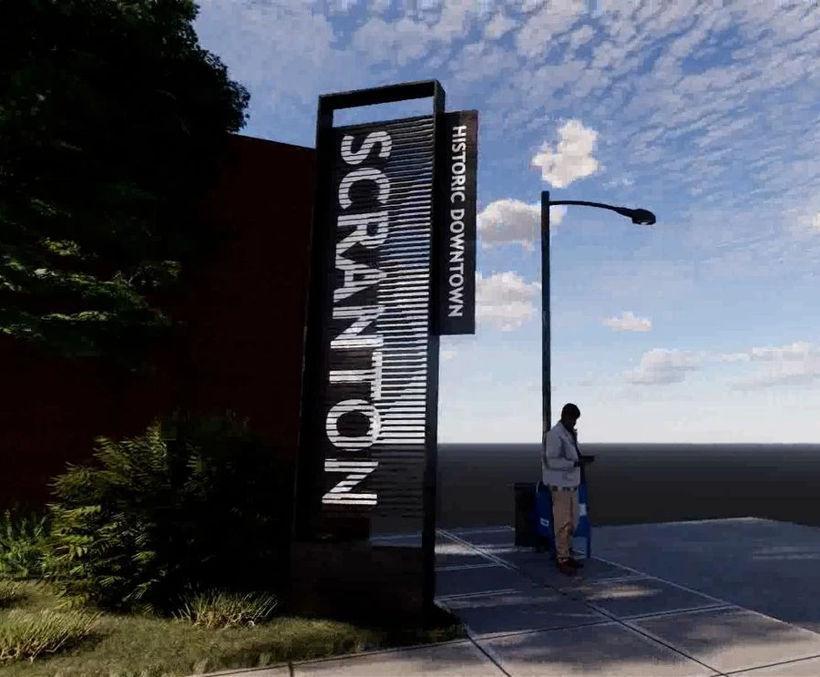
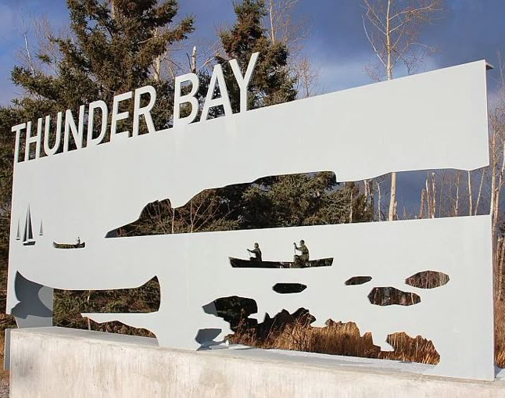
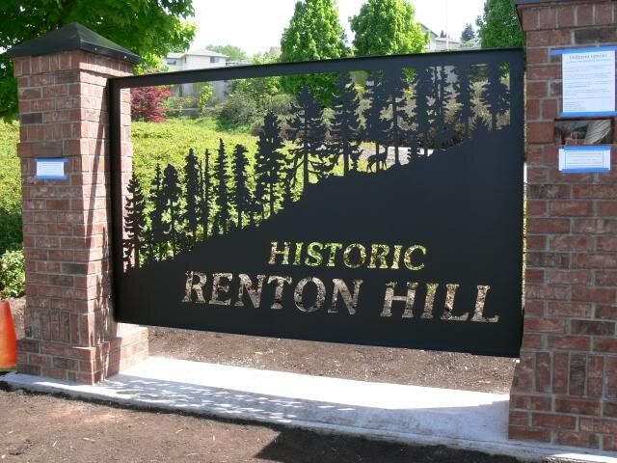
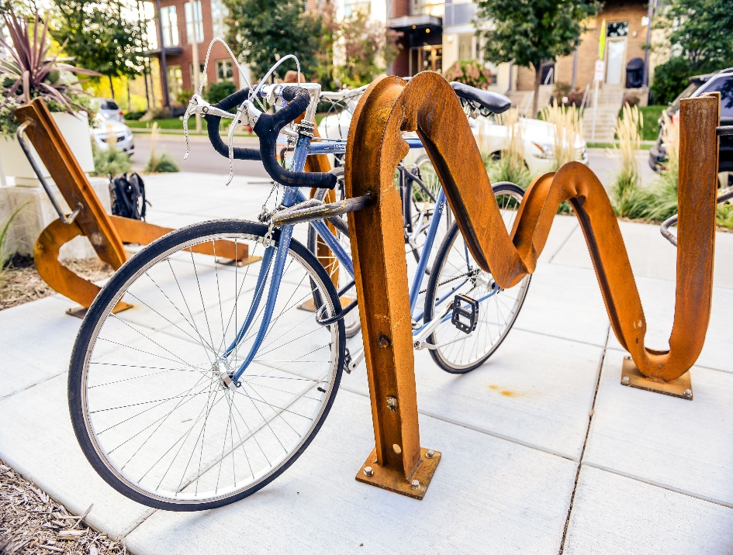
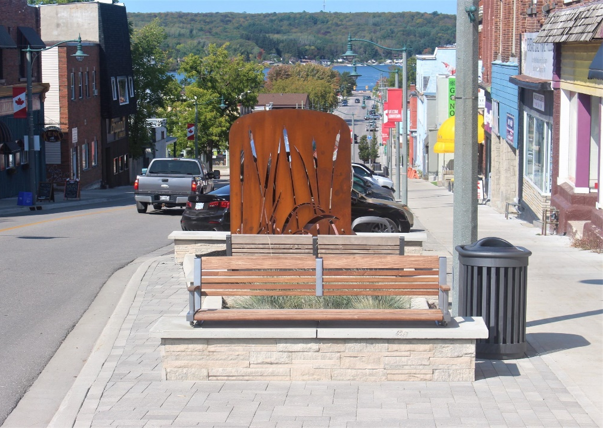
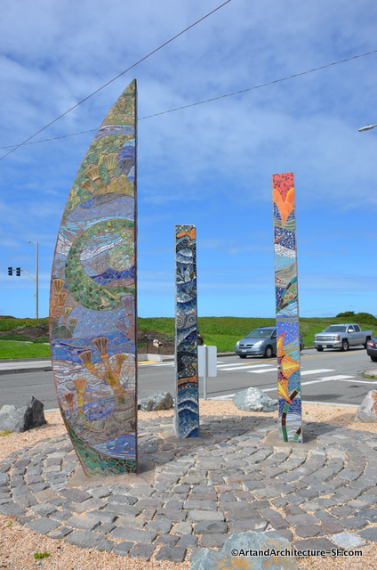
Permeable Pavers
Gateway Public Art Feature
Panel Based Art Features
Bioretention Bump Out
Notes:
Gateway elements help define downtown and reinforce a sense of place for residents and visitors.
Materials and green infrastructure choices are being evaluated for durability, maintenance, and long-term value.
Panel based art features are proposed near the Park Drive intersection.
Bioretention bump outs are also proposed at the Park Drive intersection to support stormwater management and add greenery.
Permeable pavers are proposed within the boulevard between the curb and sidewalk throughout the project limits, where feasible.
A gateway public art feature, similar to the example shown on the slide, is proposed at Park Drive.

