Slide 1
Site Alteration Permit Application
14204 Durham Regional Road 30, Town of Whitchurch-Stouffville
Lafarge Canada Inc.
March 29, 2023
Brian Zeman, President

Slide 2
SITE ALTERATION PROPOSAL OVERVIEW
Objectives of Site Alteration
Create a contiguous landform and land use between 9th Line and 10th Line north of Bloomington Road.
Re-establish historic land contours.
Accommodate an agricultural end use.
Project Description
Lafarge is proposing to re-establish agricultural and rural lands to the original topography on lands within the Oak Ridges Moraine. This would be achieved through the beneficial reuse of suitable excess soil from development projects in the surrounding area.
The regrading of the northeast corner of the Site would be a continuation of the approved site alteration occurring west of the Lafarge property. Excess soil will be placed such that the final topographic contours at the Site will be visually consistent with the elevations of the surrounding lands and match the original grade at Durham Regional Road 30.
Following the completion of the proposed alteration, the proposed future use of the Site is for agricultural use.

Slide 3
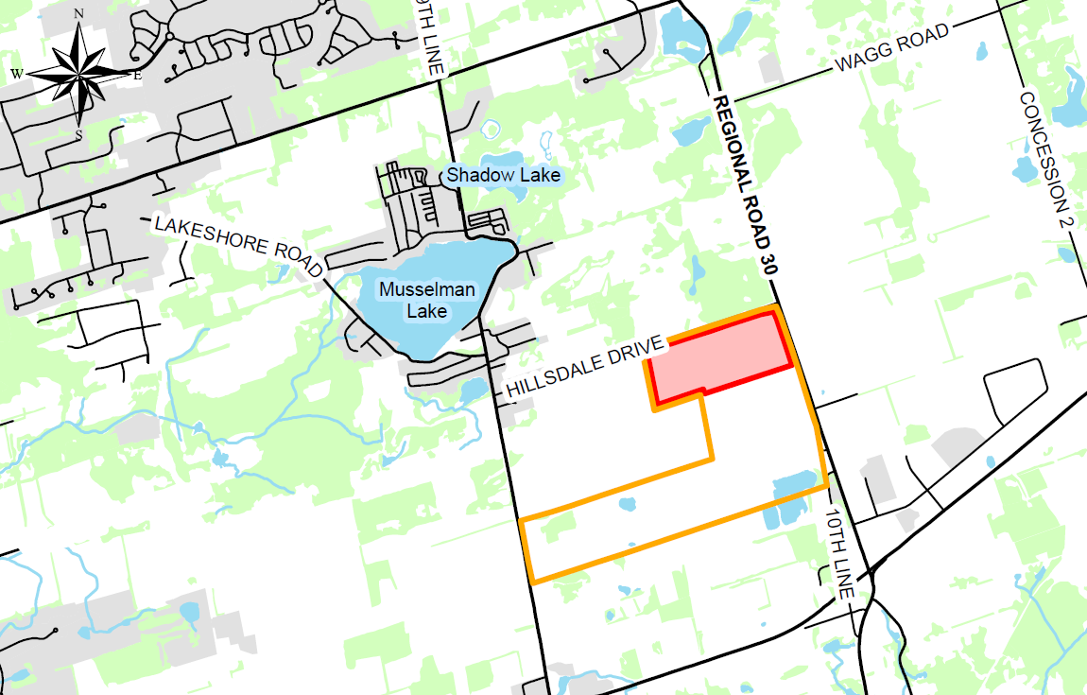
SITE LOCATION
Property: 169.2 ha
Proposed Permit Area: 37.5 ha
Aggregate extraction has been completed in the area subject to the permit application.

Slide 4
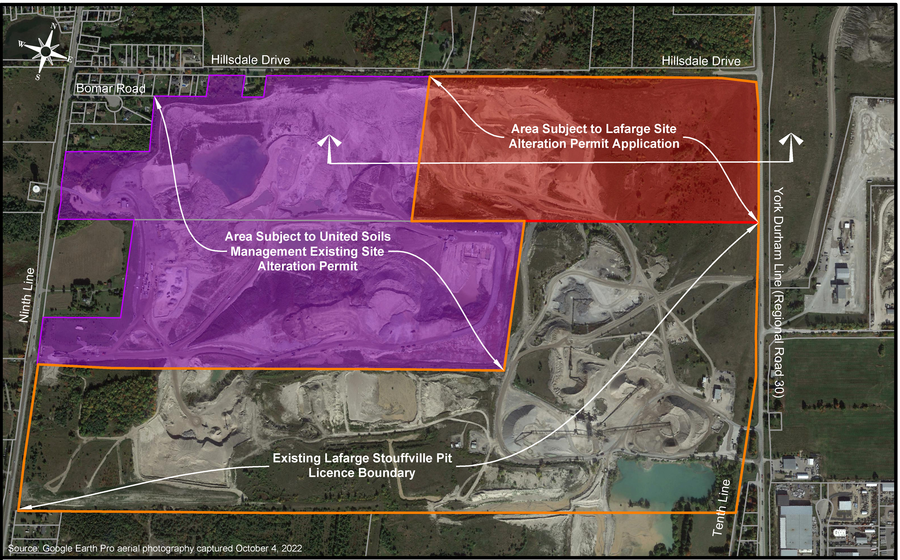
SITE ALTERATION PERMIT

Slide 5
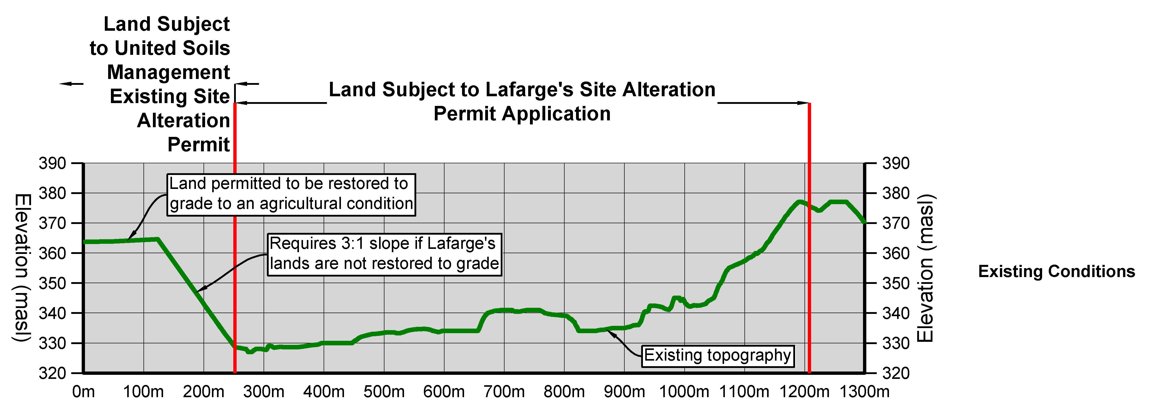
EXISTING SITE CONDITIONS
This is a view from the intersection of Regional Road 30 and Hillsdale Drive looking southwest and illustrates the existing landform for the Site if a site alteration permit is not issued.
The landform would remain approximately 30-40 metres below grade.

Slide 6
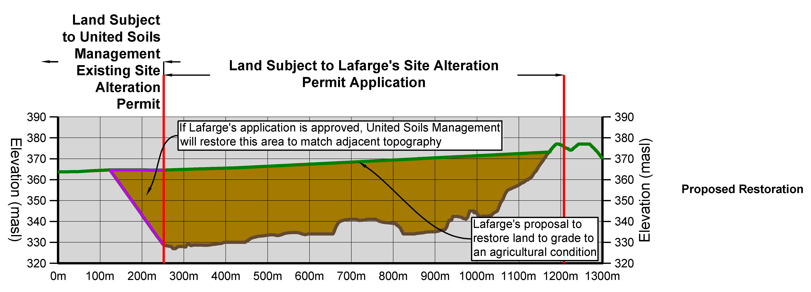
SITE ALTERATION PERMIT VISION
37.5 hectares to be restored to an agricultural use.
Restoration plan requires 8 million cubic metres of excess soil.
Area to be graded to a landform that is consistent with the approved landform on the adjacent lands to the west.
The Site will be graded to contain surface water on-site and avoid off-site flooding.

Slide 7
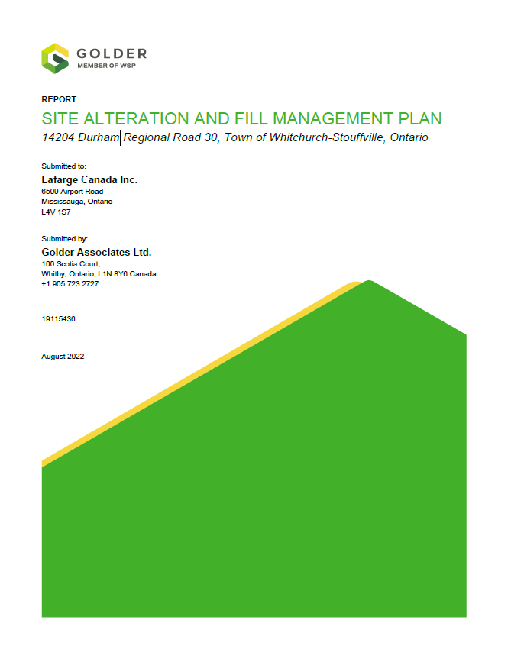
STUDIES COMPLETED
Site Alteration and Fill Management Plan, Golder
Factual Geotechnical Report, Golder
Hydrogeological Investigation, Golder
Natural Heritage Evaluation Report, Golder
Stage 1 Archaeological Assessment, Golder
Risk Management Matrix, Golder
Groundwater Monitoring Plan, Golder
Traffic Assessment Report, TYLin
Dust Management, Golder
Noise Impact Assessment, HGC Engineering
Construction Specification and Protocols, Golder
Planning Conformity Letter, MHBC Planning

Slide 8
APPLICATION HAS BEEN SUBJECT TO A THOROUGH REVIEW
Town of Whitchurch-Stouffville;
Region of Durham;
York Region;
Peer Reviewer retained by the Town;
Lake Simcoe Region Conservation Authority; and,
Toronto Region Conservation Authority.

Slide 9
AGENCY REVIEW
Region of Durham:
Primary interest was traffic on Region of Durham roads.
No outstanding concerns subject to Lafarge entering into an agreement for required road improvements and traffic calming measures in the Village of Goodwood.
York Region:
Primary interest was traffic on Region of York roads.
No outstanding concerns and Lafarge has entered into an agreement to implement Regional conditions.
TRCA and LSRCA:
Primary interest was protection of the natural environment and water resources.
No outstanding concerns.
Town of Whitchurch-Stouffville:
Primary interest was all aspects of the proposed operation and protection of the surrounding community.
Detailed technical review completed by peer reviewers retained on behalf of the Town.
Lafarge’s Management Plan was updated to address all Town/peer review comments to ensure compliance with the Town’s Fill and Site Alteration By-law No. 2019-068-RE.

Slide 10
SOIL ACCEPTANCE PROTOCOL
Prior to the acceptance of excess soils at the Site, soil is tested at the source to confirm the required soil quality is met under the direction of a Qualified Person (QP).
Once the material has been deemed suitable to be accepted at the Site, all loads of excess soil are tracked to ensure only pre-qualified material is transported to the Site.
All inbound trucks must check in with onsite attendant, loads are inspected prior to dumping to verify pre-qualification standards are met and verification sampling is completed every 70 loads.

Slide 11
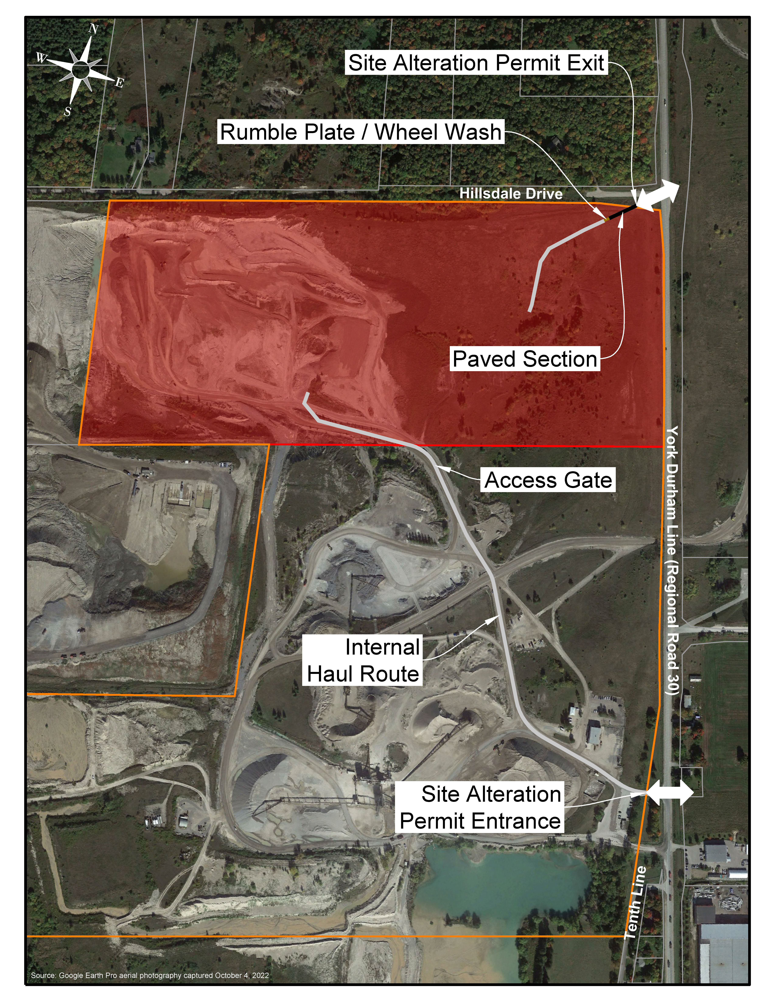
TRAFFIC
Trucks entering the Site would use the existing entrance to the Stouffville Pit on Regional Road 30.
Trucks exiting the Site would use a new exit onto Hillsdale Drive.
Operations from 7:00 am to 5:00 pm Monday to Friday.
No operations on weekends or statutory holidays.

Slide 12
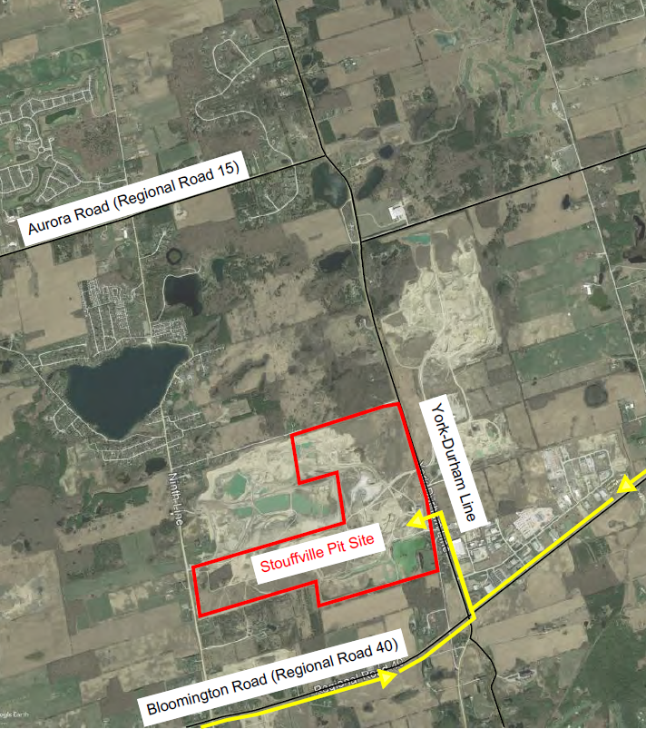
TRUCK ROUTE – INBOUND
Lafarge has committed to install a left turn lane into the existing Stouffville Pit.
The construction of this left turn lane will require a traffic management plan to be approved by the Region of Durham and will ensure northbound and southbound traffic remains open.

Slide 13
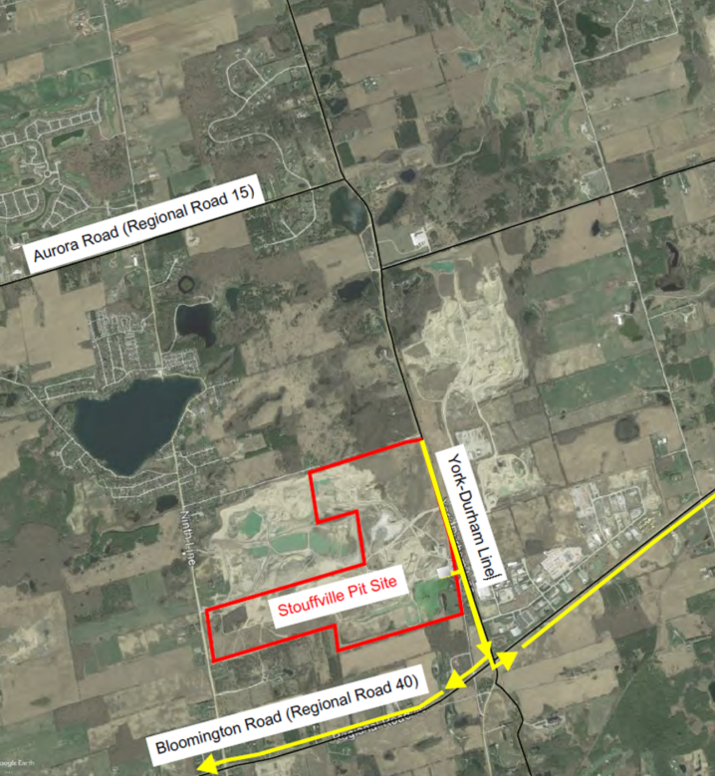
TRUCK ROUTE – OUTBOUND
All trucks exiting the Site will go south on Regional Road 30 (York Durham Line).

Slide 14
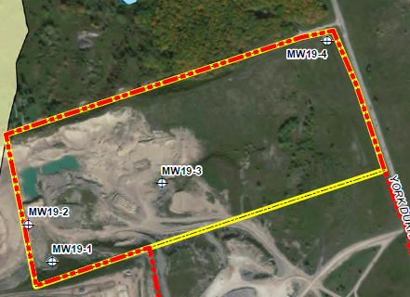
PROTECTION OF GROUNDWATER
Operations are above the water table.
Site is located outside of a wellhead protection area.
All soil brought on-site will be to a quality to protect groundwater resources.
4 groundwater monitoring wells and semi annual groundwater quality testing.

Slide 15
NOISE AND DUST MITIGATION
A noise and air quality report was completed to ensure provincial standards are met at all surrounding receptors.
To control noise there is a limitation on the amount of equipment that can operate on-site and the requirement for noise berms along the northern boundary.
To control dust, a Best Management Practices Plan has been prepared. The Plan includes preventative procedures, a description of the required mitigation and the frequency of the required procedure.

Slide 16
REGULAR REPORTING & MONITORING TO THE TOWN
Monthly Reports:
Confirmation of imported excess soil volume and quality of material to the Site.
Semi-Annual Report:
Operation report and summary of the resolution of any concerns.
Annual Reporting:
Record of import and source material placement of excess soil.
Summary of concerns and resolutions.
Environmental monitoring results, compliance audits and assessments.

Slide 17
PUBLIC COMPLAINT PROCEDURE
Lafarge will maintain an online system for receiving public complaints.
A response to any complaint will be provided within 2 business days.
Each complaint will be investigated and documented through an incident report with any operational protocols required.
A copy of the complaint and response will be provided to the Town.

Slide 18
INSPECTION AND ENFORCEMENT
If Town Council issues the site alteration permit, the Town has full authority to inspect and ensure that Lafarge implements all of the requirements of Lafarge’s Management Plan and Town By-law 2019-068-RE.
The Town also has the authority to issue orders to ensure compliance and complete the work at Lafarge’s expense if the order is not complied to within the required timelines.

Slide 19
NEXT STEPS
Consider any public comments received at the public meeting.
If required make additional updates to the Management Plan to address public comments.
Application will come back to Town Council for a final decision.
Lafarge will enter into required agreements with Region of Durham for required traffic improvements.

Slide 20
Questions
March 29, 2023

